Slide 1
Natural Language Processing
Unit 8 Shallow Parsing
Faizan Javed
DataScience @ SMU

Slide 2
Admin notes
Midterm exam next week (no class)
HW5 due next week

Slide 3
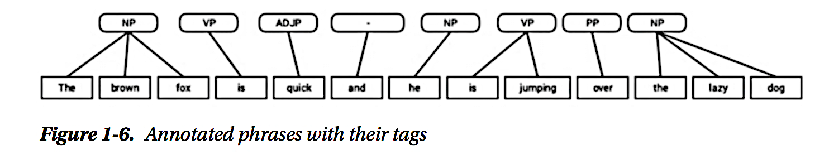
Shallow Parsing
Structure hierarchy:
Sentence > Clause > Phrase > Word
Word: Smallest language unit, has four major categories Noun, Verb, Adjective, Adverb
Phrase: usually groups of two or more words (without both subject and verb), has 5 major categories NP, VP, ADJP, ADVP, and Prepositional Phrase. Used as part of sentences
Shallow parsing is used to extract phrases.

Slide 4
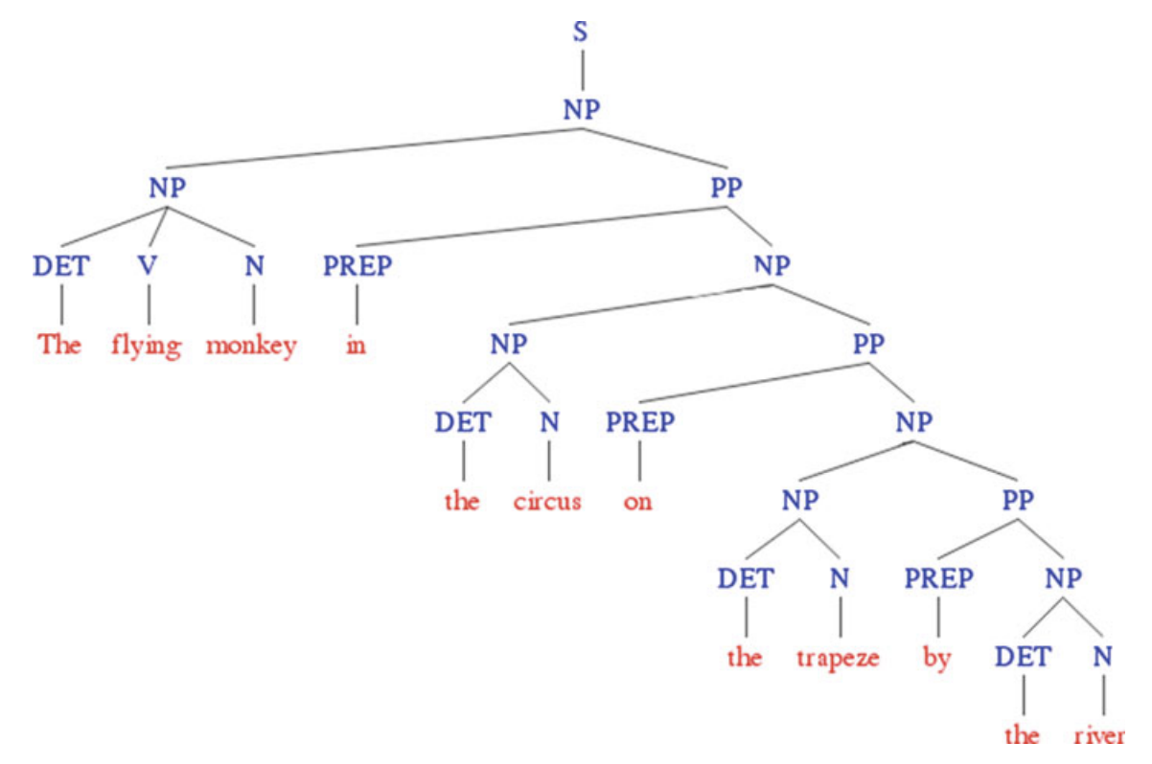
POS Tagging vs Shallow Parsing vs Full Parsing
POS Tagging: shallowest – POS tags only
Shallow Parsing/Chunking: grouping POS tags into
“phrases”, obtain semantically meaningful phrases
and relations
Chinking: syntax elements not part of chunks
Full Parsing: complete internal syntax
Chunking vs Full Parsing:
Full parsing is computationally expensive
May not be accurate for free form/unstructured text such as UGC (user generated content)
Usually for niche applications only (machine translation, question answering)

Slide 5
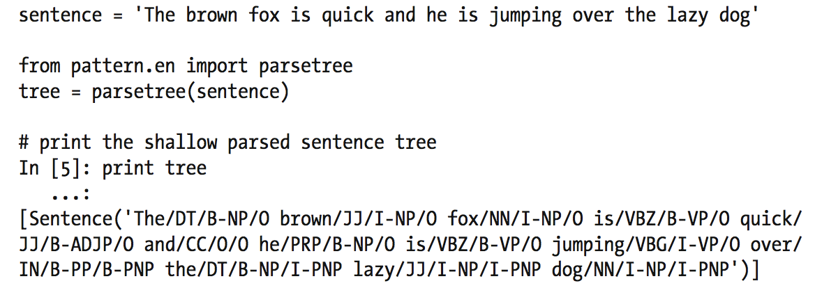
Shallow Parser Output
Tag prefixes:
B- tag: beginning of a chunk, and
I- tag: inside a chunk.
O- tag: token does not belong to any chunk.

Slide 6
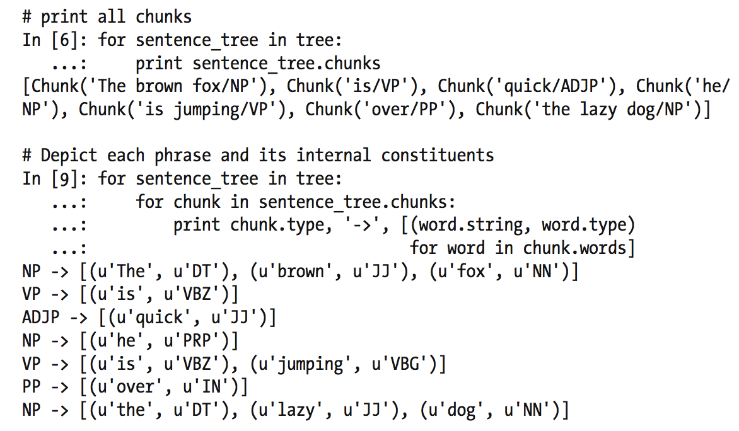
Shallow Parser Output – alternative format

Slide 7
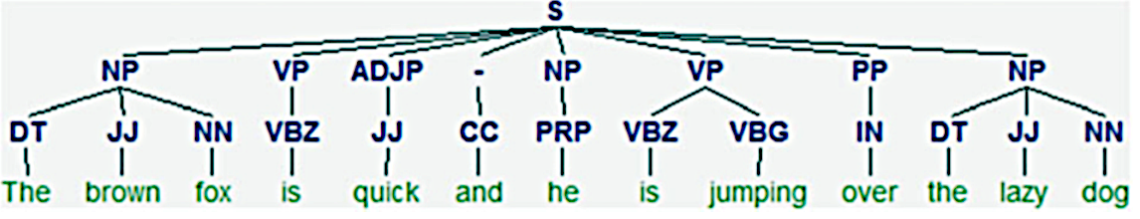
Shallow Parser Output – visualization

Slide 8
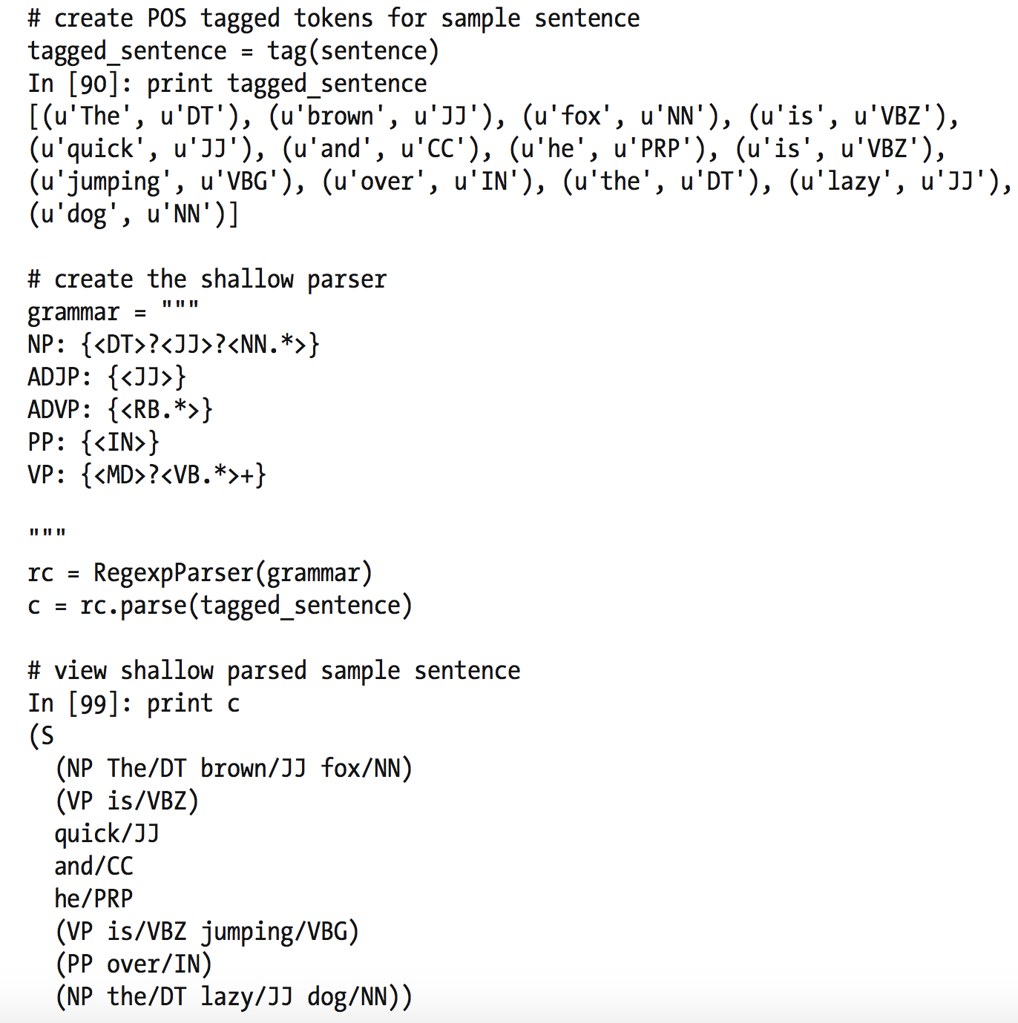
Shallow Parsers – Regular Expression Parser

Slide 9
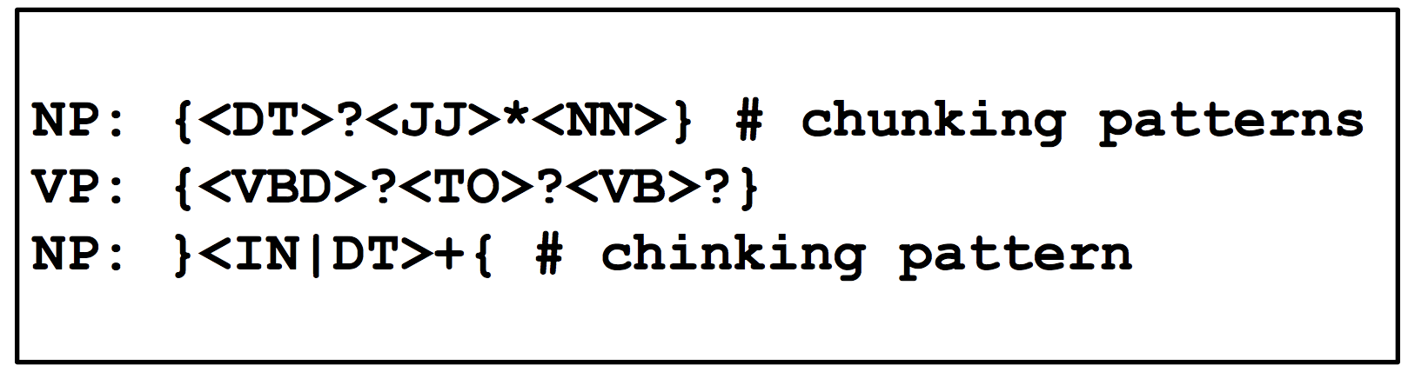
Shallow Parser – Regular Expression parser
(similar to POS Tagger): difficult to maintain and scale for industrial applications
RegExp patterns for large scale text corpus can be laborious to construct.
“Sometimes it is easier to define what we don't want to include in a chunk than it is to define what we do want to include.”

Slide 10
Shallow Parser – Classifier based parser
RegEx features: POS Tags, tag frequencies –
Sometimes just POS tags aren’t sufficient to determine how to chunk a sentence (despite having same POS tags)
Joey/NN sold/VBD the/DT farmer/NN rice/NN ./.
Nick/NN broke/VBD my/DT computer/NN monitor/NN ./.
Greedy sequence classifier: analyze training data one sentence at a time, predicts a tag for the first element and store its features and predictions in history, does the same for the second tag, etc
ConsecutiveNPChunkTagger class: (uses the maximum entropy classifier)

Slide 11
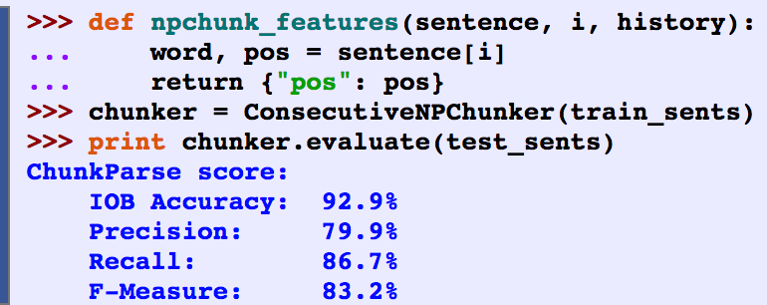
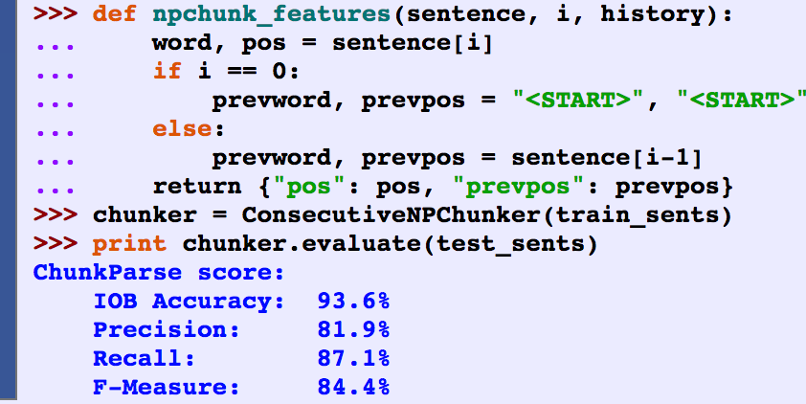
Shallow Parser – Classifier features
Version 1: POS tag of the current token (similar to unigram chunker)
Version 2: add previous POS tag (models interaction between adjacent tags – similar to bigram chunker)

Slide 12
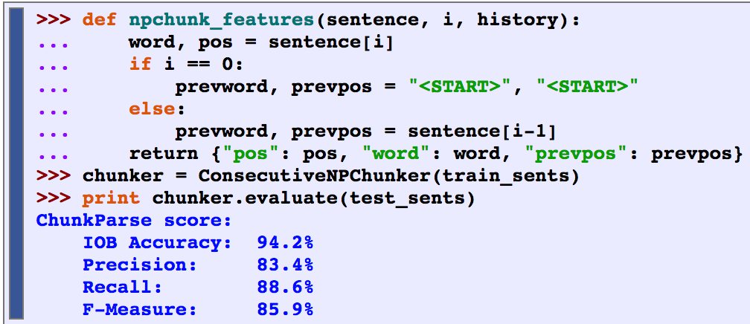
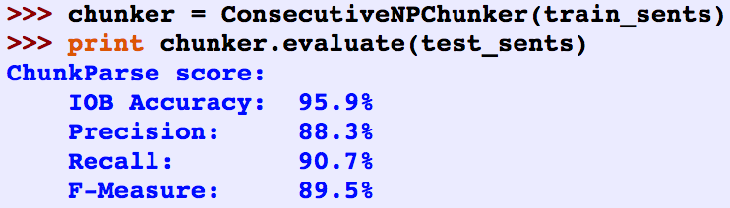
Shallow Parser – Classifier features
Version 3: add a feature for the current word (word content can be useful for chunking)
Version 4: add lookahead, paired, contextual features (set of all POS tags since the most recent determiner)

Slide 13
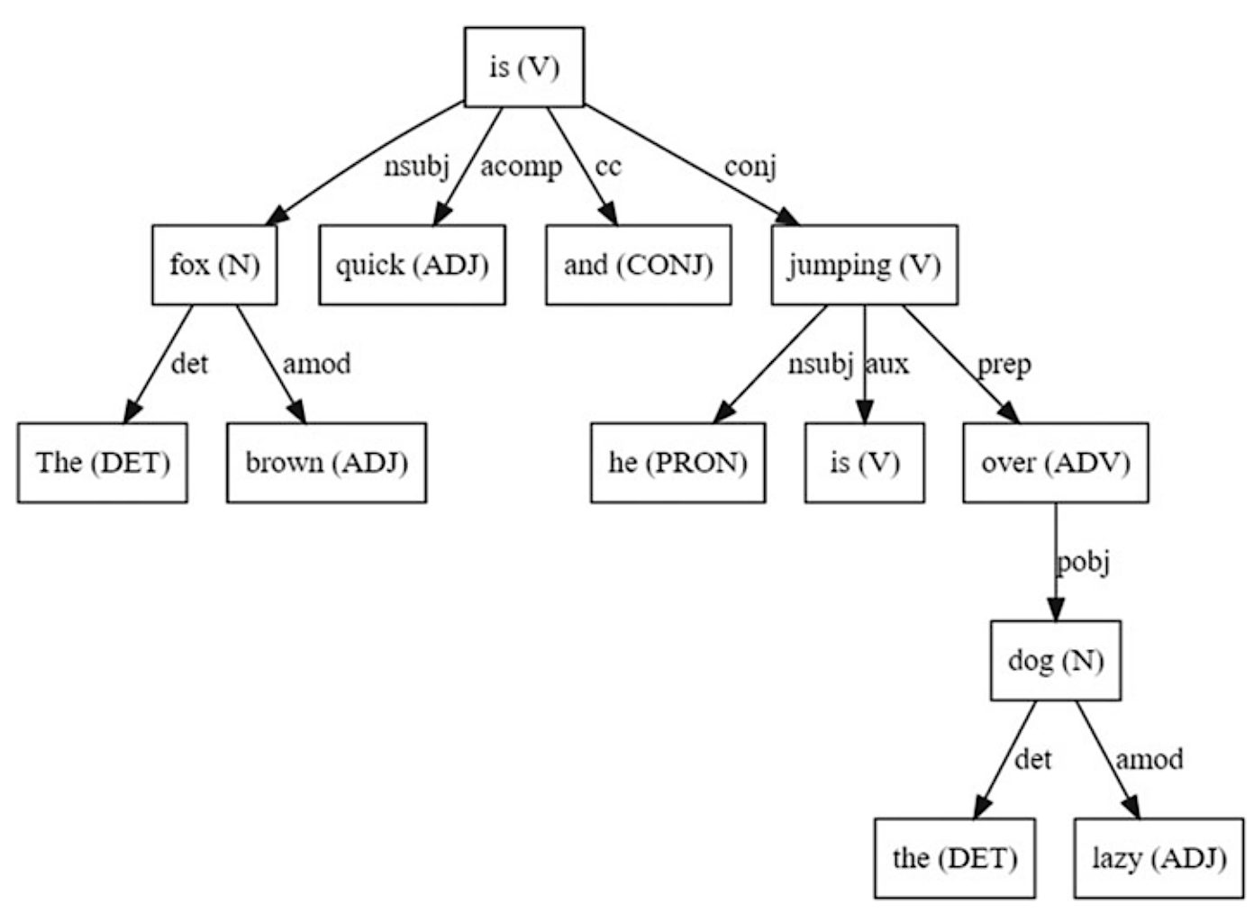
Dependency Grammars
Grammar: defines the syntax and structure of language.
Dependency grammar (word-based grammars): A word has a relation or depends on another word based on the positioning of the words in the sentence
Directed acyclic graph (DAG): Every node in the tree has at most one incoming edge, except the root node.
Examples:
det →(fox, the), (dog, the)
nsub (entity that acts as a subject of agent)
→ (is, fox), (jumping, he)

Slide 14
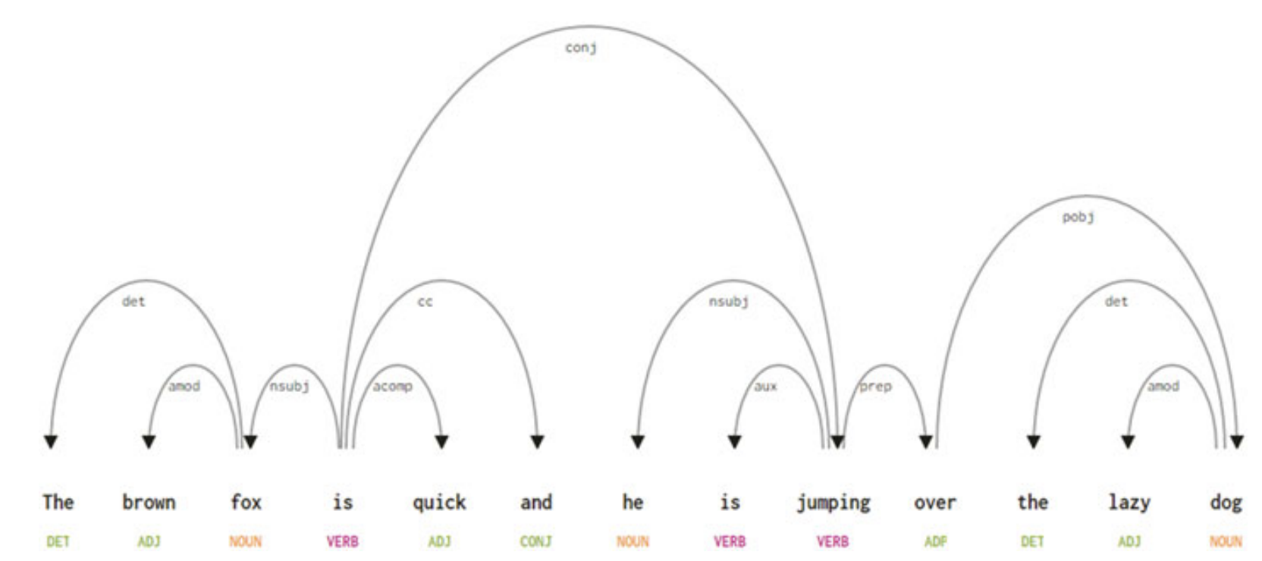
Dependency Grammars

Slide 15
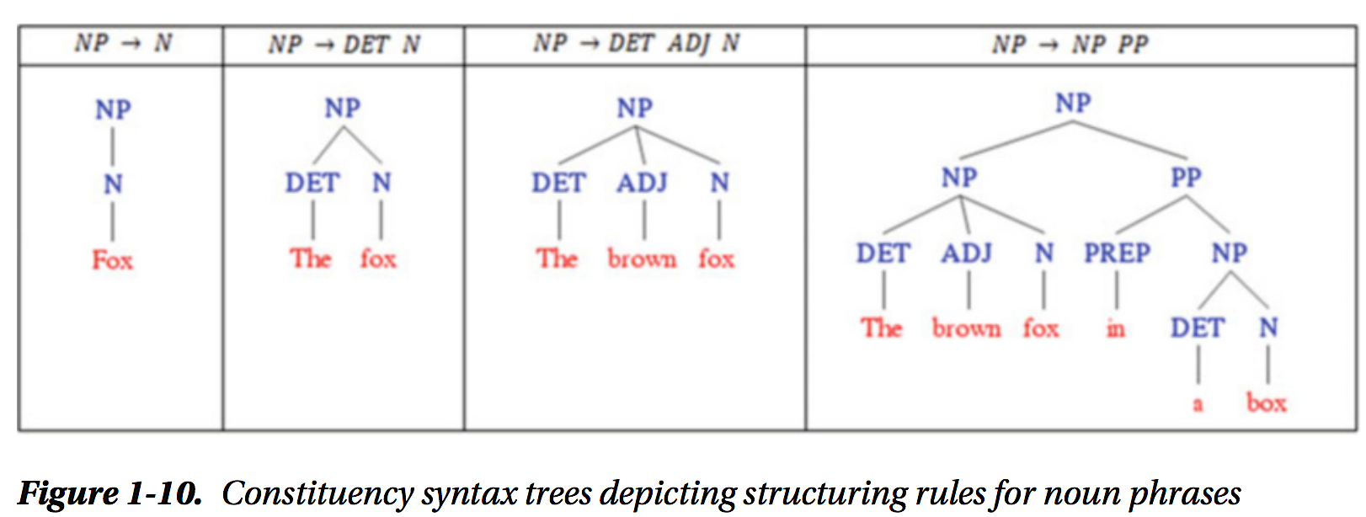
Constituency Grammars (phrase structure grammars)
Syntax and rules that govern the hierarchy and ordering of the various constituents in the sentences.
What words are used to construct the phrases or constituents
How to order these constituents together

Slide 16
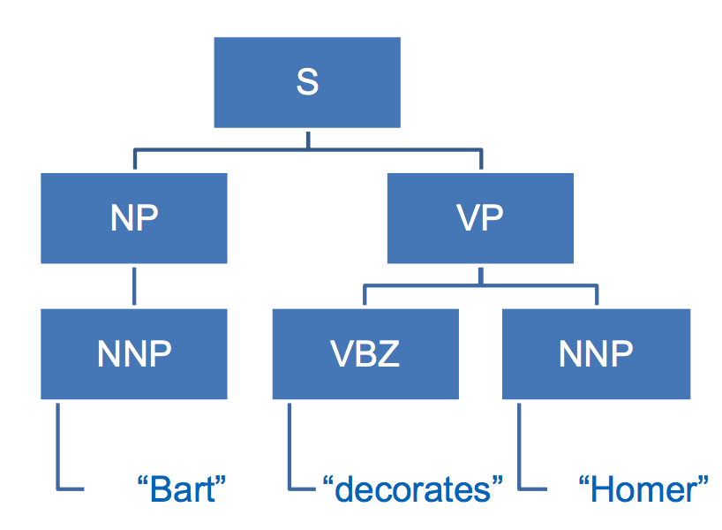
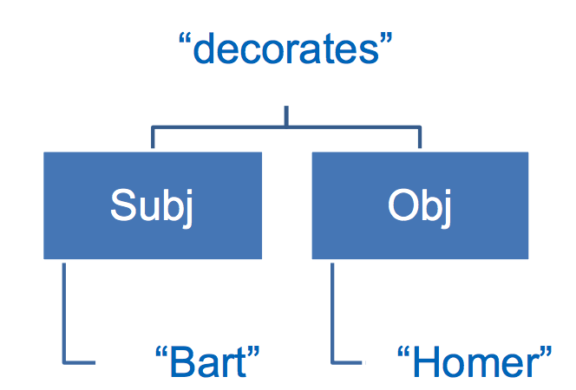
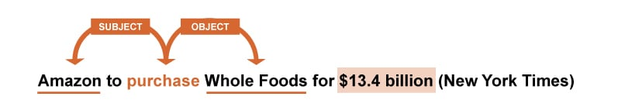
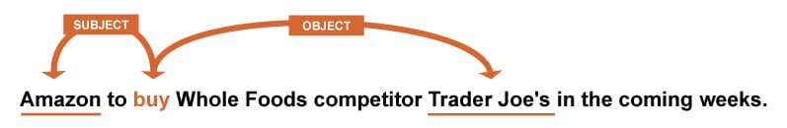
Constituency vs Dependency Parsing

Slide 17
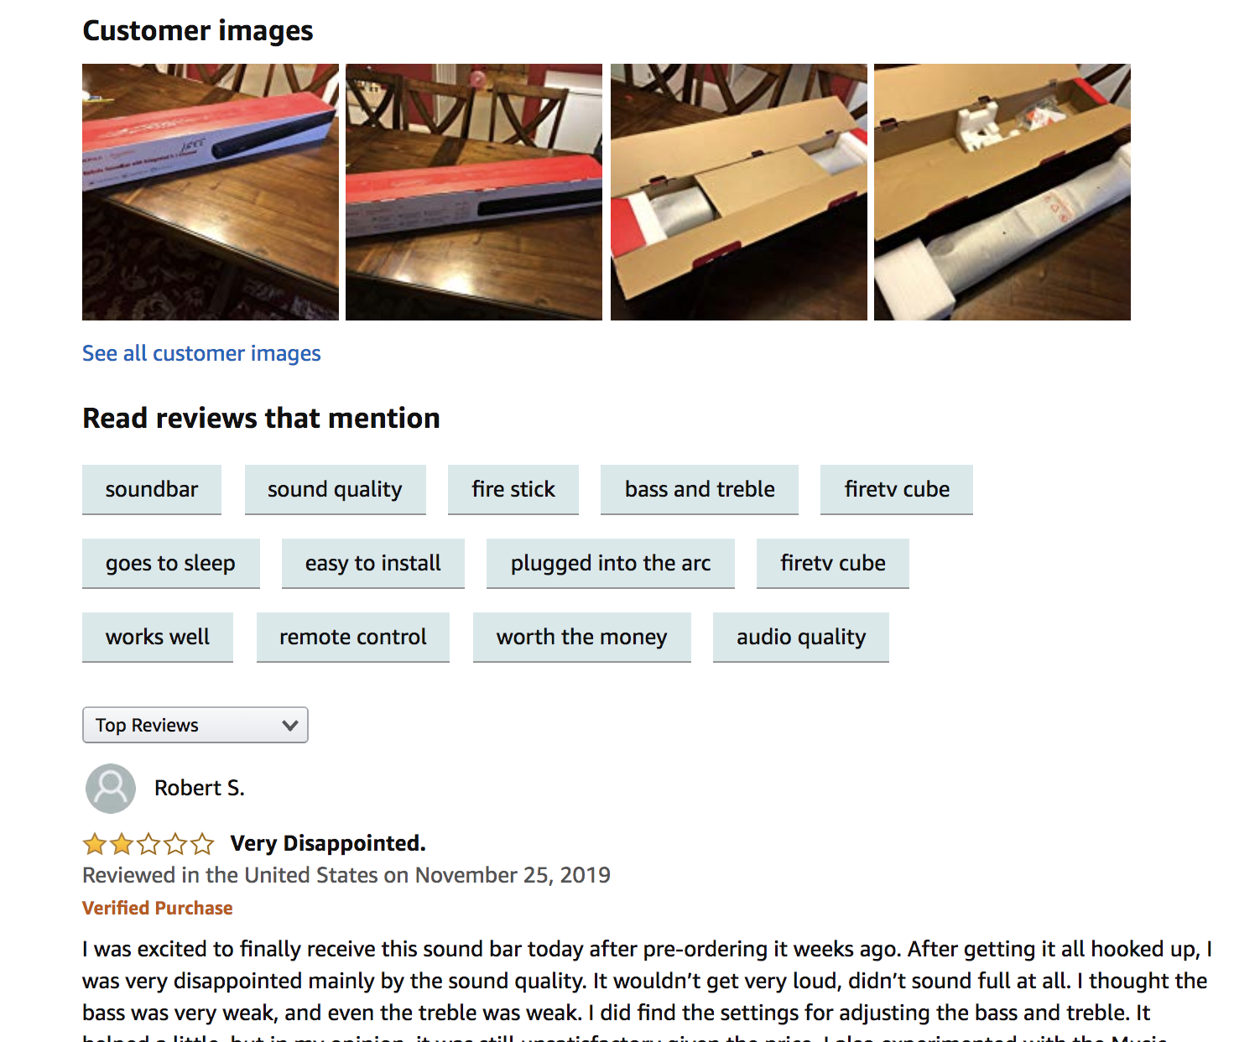
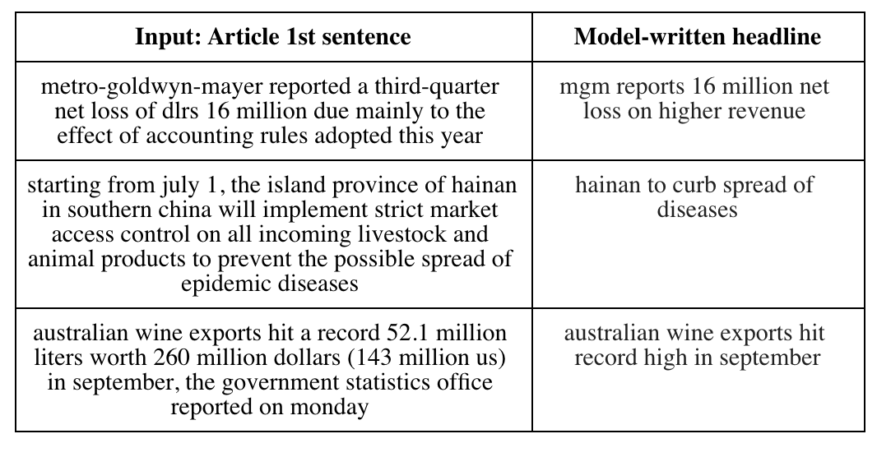
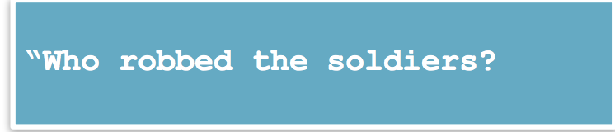
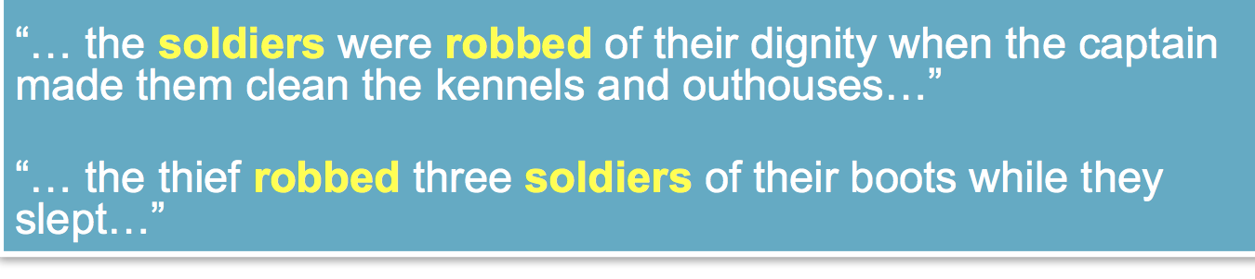
Constituency vs Dependency Parsing: Use cases
Constituent parsing: key-phrase extraction, document summaries, product/user review highlights
Dependency parsing: question-answering, chatbots, conversational AI
Which answers have soldiers as the object not the subject of robbed

Slide 18
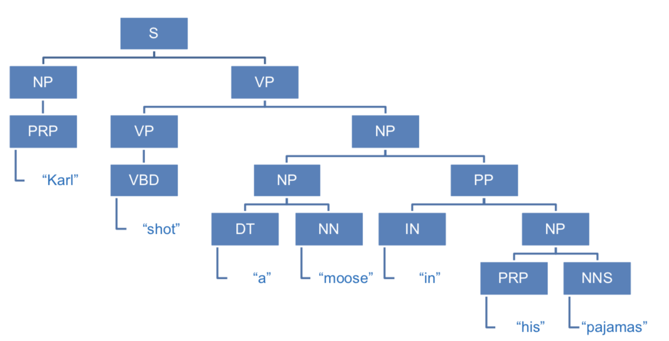
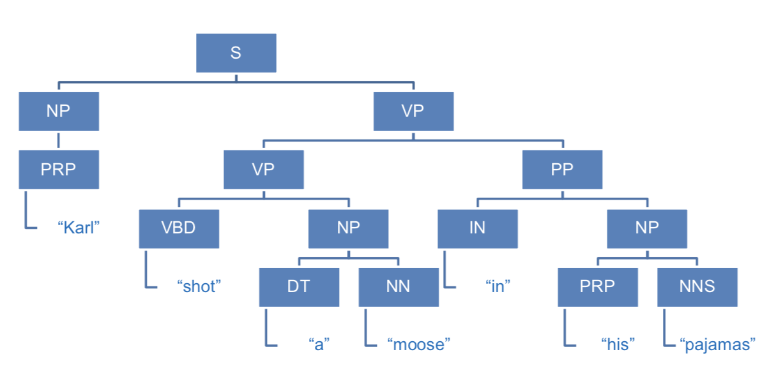
Ambiguity in Parse Trees
Need higher level semantic analysis to answer the question: Who was wearing pants?

Slide 19
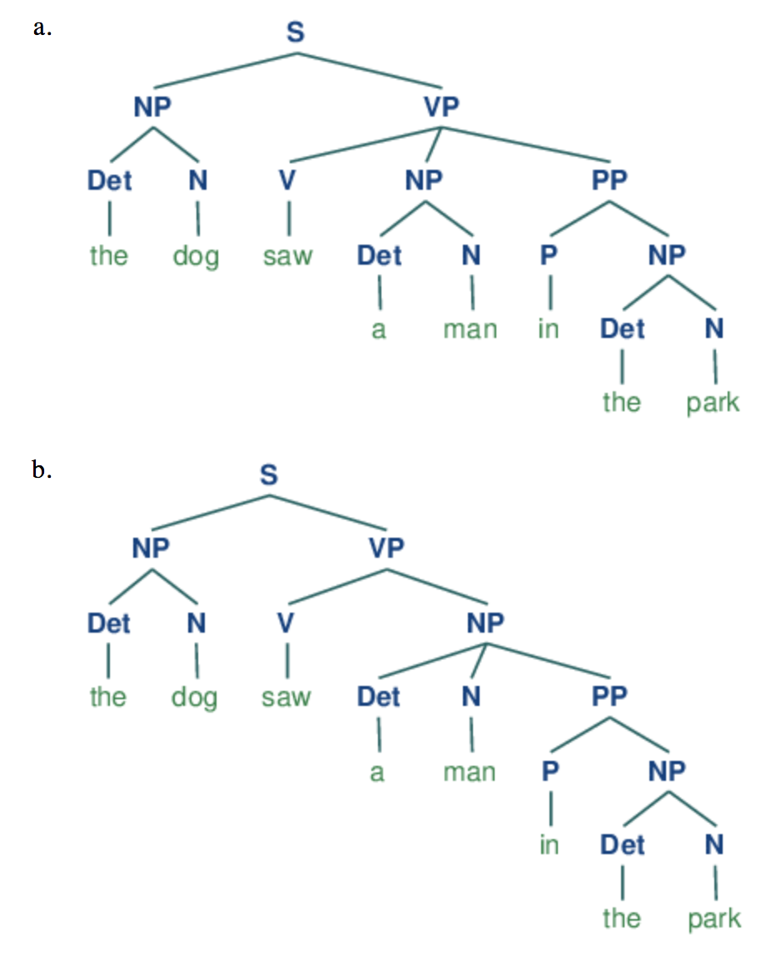
Ambiguity in Parse Trees
“the dog saw a man in the park”
Syntactic ambiguity
Prepositional phrase: In the park
Can be child of:
VP: (seeing event happened in the park)
NP: (man who was in the park – dog might be
seeing it from an apartment)
A higher-level semantic analysis would be needed
to determine the correct parse tree

Slide 20
What did you learn today?
Questions?

